Slide 1
LDA Based Recommendation Engine for Adobe Learning Manager
Code Raiders
Ishan Sinha
Chirag Kulshreshtha

Slide 2
Index
Objective
Proposed Solution
Topic Modeling & LDA
Steps Performed for model
Steps to execute code
Output

Slide 3
Objective
Building a good recommendation engine that can help ALM users in recommending good courses (or content) based on their history.
A visitor might be on ALM site & he logged in to ALM and browsed several topics.
Visitor moves from one page to another on ALM site. We can collect his information and use a statistical model (or Machine Learning model) to predict which courses (or course categories) can be best suited for him based on web pages he has visited.
Notes:
Note:-

Slide 4
Proposed Solution
A visitor on ALM website will be browsing pages & we can collect many pointers around his browsing behavior like Page titles, Page/ Course Descriptions, Region, Device Type etc.
Now this information can be used to generate recommendations to him like which courses he can go through in the future.
Latent Dirichlet allocation (LDA) is one technique widely used for topic mining in Natural Language Processing.
We have utilized LDA in our solution approach for predicting courses (‘topics’ in LDA terms) based on title and description of courses.

Slide 5
Topic Modelling & LDA
Topic modeling is a method for unsupervised classification of documents, similar to clustering on numeric data, which finds some natural groups of items (topics) even when we’re not sure what we’re looking for.
Topic modeling provides methods for automatically organizing, understanding, searching, and summarizing large electronic archives.
A document can be a part of multiple topics, kind of like in fuzzy clustering(soft clustering) in which each data point belongs to more than one cluster.
LDA is one of the most popular topic modeling methods. Each document is made up of various words, and each topic also has various words belonging to it. The aim of LDA is to find topics a document belongs to, based on the words in it.

Slide 6
Topic Modelling & LDA
Let’s say we have 2 topics that can be classified as CAT_related and DOG_related. A topic has probabilities for each word, so words such as milk, meow, and kitten, will have a higher probability in the CAT_related topic than in the DOG_related one. The DOG_related topic, likewise, will have high probabilities for words such as puppy, bark, and bone.
If we have a document containing the following sentence:
“Dogs like to chew on bones and fetch sticks. Puppies drink milk. Both like to bark.”
We can easily say it belongs to topic DOG_related because it contains words such as Dogs, bones, puppies, and bark. Even though it contains the word milk which belongs to the topic CAT_related, the document belongs to DOG_related as more words match with it.

Slide 7
Steps Performed for model
Initial Analysis & Variable/ Parameter Identification
Data Collection
(Referred course_metadata.csv from here)
Sampling
(Our Sample should contain good mix of titles and descriptions
Data Preprocessing(Tokenization, Removing Stop Words, Lemmatization, n-grams formation)
Model Building (Model Selection & training)
Model Accuracy & Optimization (Fetch metrics like Avg. Topic Coherence for trained model.)
Model Deployment(Saved the model to a folder in D drive )

Slide 8
Steps to execute code
* Install dependencies of Py from requirements.txt
Execute “data_cleaning.py”
Remove duplicates
Translate all records to English in batches
Execute “Merge intermediate translated file.py”
Read all files from ‘intermediate’ folder
Execute “Recommendation_Engine_Model.py”
Read the merged file
Lower Casing All Descriptions, Tokenizing, Removing tokens with length < 2 and removing stop words.
Lemmatizing the tokens
Replace Special characters with spaces
Fill empty rows
Merge all files to one
Create N-grams & visuals
Train and test model

Slide 9
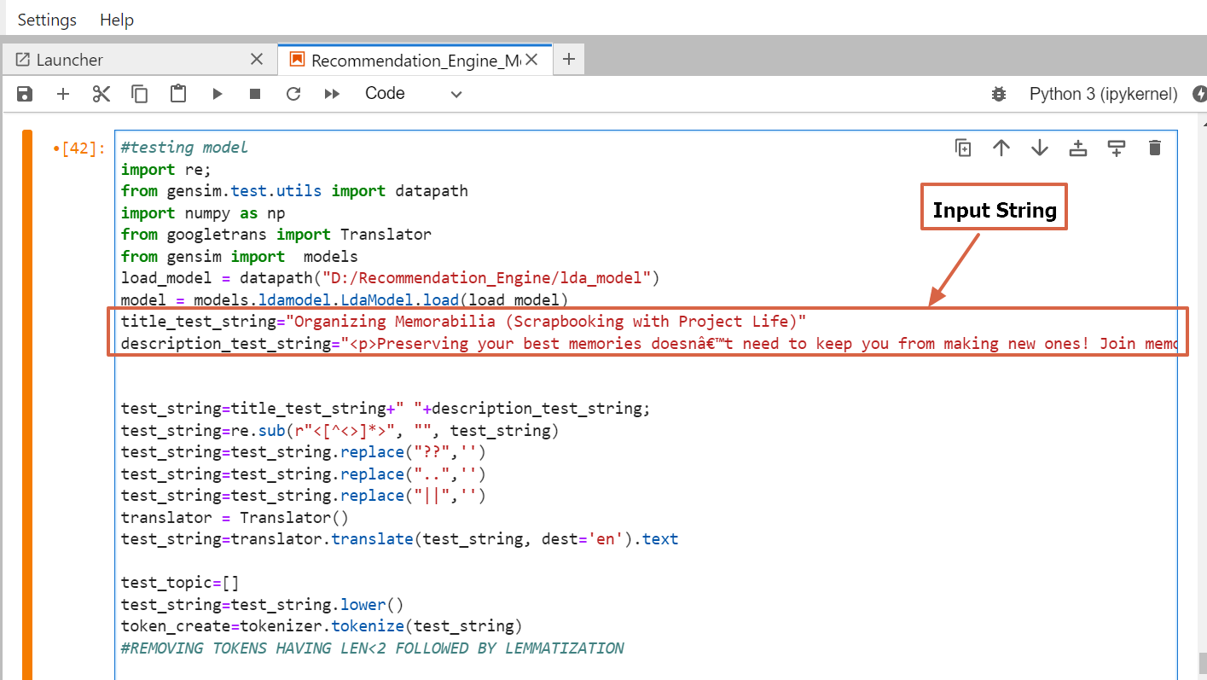
Output
Output

Slide 10
References
https://towardsdatascience.com/latent-dirichlet-allocation-lda-9d1cd064ffa2
https://www.geeksforgeeks.org/latent-dirichlet-allocation/
https://www.analyticsvidhya.com/blog/2021/05/topic-modelling-in-natural-language-processing/
https://towardsdatascience.com/topic-modeling-and-latent-dirichlet-allocation-in-python-9bf156893c24

Slide 11
Thank You

